Slide 1
Statistical Workshop
on the Raising Procedures for Med&BS Biological data
Methodological Approaches of Romania
Alexandru Gheorghe
Online Meeting, 16th of January 2025

Slide 2
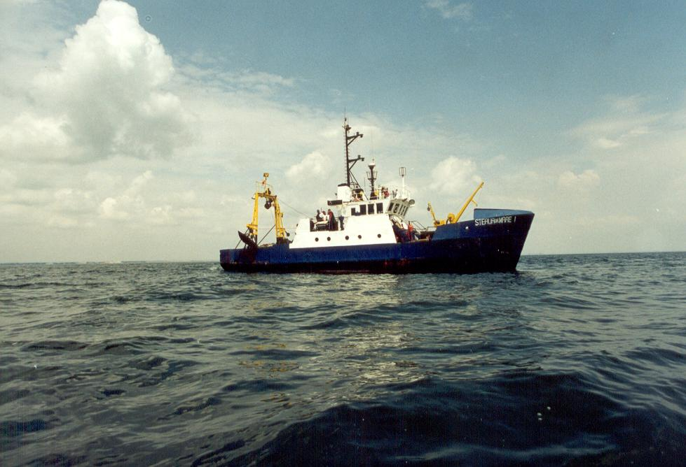
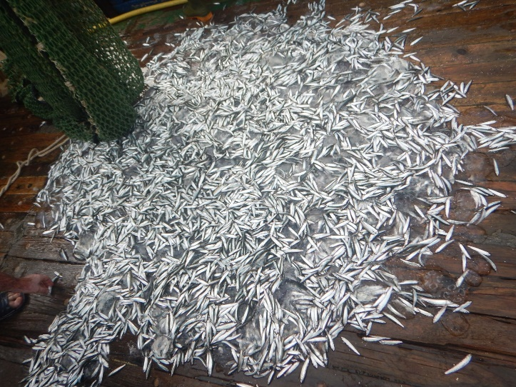
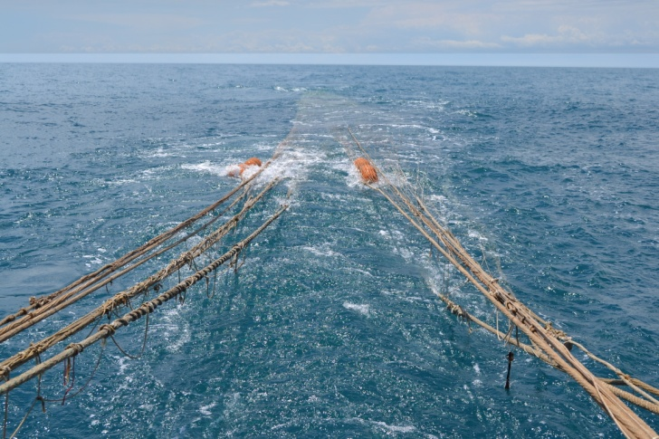
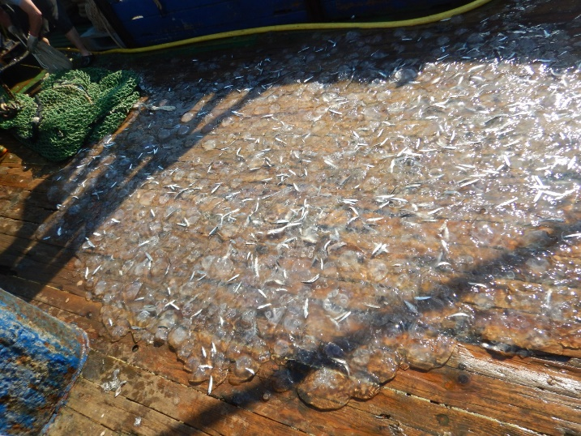
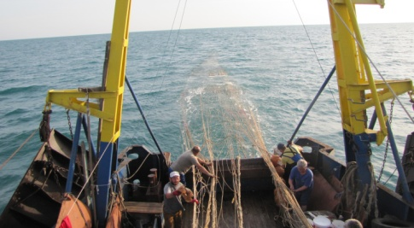
Romanian Surveys
Pelagic trawl survey in the Black Sea (PTSBS)
Spring and Autumn
Bottom trawl survey in the Black Sea (BTSBS) Spring and Autumn

Slide 3
Pelagic trawl survey in the Black Sea (PTSBS)
The aim of the pelagic trawl survey in the Black Sea is the assessment of the stock biomass of sprat (Sprattus sprattus). Furthermore, an analysis of the distribution and abundance of the other species caught as by-catch.
The submitted data are collected by standard techniques (pelagic trawl) and methodology, which remained constant by sampling. The vessel's GPS system is connected to the NAFA satellite system for fishing vessel monitoring system (VMS) and the vessel's location is strictly controlled during trawling activities. The data analysis is performed by the "swept area method" and the results obtained can be reproduced and compared.
Information collected through pelagic trawl activities:
* GPS coordinates from the start and of trawling;
* The depth measured with the vessel acoustic probe;
* The mean trawling speed (Nd);
* Time / trawling duration;
* The total catch;
* The abundance of the target species;
* Total catch weight;
* The absolute and standard length, individual weight;
* The otoliths extraction for age determination;
* The sex determination;
* The composition of by-catch species;
* The discharged catches.
Pelagic expeditions for the assessment of sprat agglomerations provide additional information for the calculation of the catch effort per unit CPUE (kg/hour) and of catch per unit area CPUA (kg/m2) in the researched areas. The collected data are stored in the NIMRD database, as well as in a special module created within NAFA Romania.

Slide 4
Bottom trawl survey in the Black Sea (BTSBS)
The aim of the bottom trawl survey in the Black Sea is the assessment of the stock biomass of turbot (Scophthalmus maximus), along the Romania Black Sea coast, estimation of the biomass and abundance of the reference species by depth strata and study of size/age and sex structure, food composition, by-catch, distribution of the stock. Furthermore, an analysis of the distribution and abundance of the other species caught as by-catch.
The submitted data are collected by standard techniques (bottom trawl) and methodology, which remained constant by sampling. The vessel's GPS system is connected to the NAFA satellite system for fishing vessel monitoring system (VMS) and the vessel's location is strictly controlled during trawling activities. The data analysis is performed by the "swept area method" and the results obtained can be reproduced and compared.
Information collected through bottom trawl activities:
* GPS coordinates from the start and of trawling;
* The depth measured with the vessel acoustic probe;
* The mean trawling speed (Nd);
* Time / trawling duration;
* The total catch;
* The abundance of the target species;
* Total catch weight;
* The absolute and standard length, individual weight;
* The otoliths extraction for age determination;
* The sex determination;
* The composition of by-catch species;
* The discharged catches;
* The stomach content (turbot)

Slide 5
Bottom trawl survey in the Black Sea (BTSBS)
All the data collected from demersal research expeditions are entered in the program developed by COISPA, Biondex Script running in program R, through fisheries data processing software, including statistical data processing, in accordance with the requirements of the European Commission Regulations. Before entering the data in the Biondex script, are organized in the format of MEDITS tables, being verified with the RoME script to perform multiple data checks.
The results obtained by running this script are saved in the OUTPUT folder, like JPEG, TIFF and CSV files and are presented like maps and tables that include data related to:
* the surface of the researched square (Km2, m2);
* the average mass per unit area (g/m2, t/Km2);
* the mass limits variation per unit area;
* the total biomass values (t);
the abundance index (individuals/km2).
In order to establish the abundance and biomass of pelagic and demersal species, at the Romanian Black Sea coast, the standard methodology for stratified sampling is applied. The analyzed area at Romanian Black Sea coast is divided into four layers, depending on the depth: Stratum 1 (0-30 m), Stratum 2 (30-50 m) and Stratum 3 (50-75 m). Also, to assess the abundance and biomass of pelagic and demersal species, the analyzed area is divided into 57 squares, each with sides of 10 x 10 Mm, surface of 100 Nm2 (or 2000 – 2500 Mm2). On board of the vessel, the absolute and standard length, as well as the individual weight, are measured to determine the size and weight structure of the turbot stock and to estimate the share of specimens with a length below that allowed in the fisheries legislation.

Slide 6
Methods of sampling and storage
Sampling of ichthyoplankton
The qualitative and quantitative composition of the ichthyoplankton is determined by analyzing the samples taken from fixed stations, located on a part of the Romanian platform (up to the 70 m isobath), the methodology for collecting and processing the samples being the one unanimously accepted for the Black Sea basin.
The collection is usually done with the Bongo fillet with a diameter of 60 cm, with a mesh of 505 mm, equipped with a flow meter for recording the distance traveled, through oblique trajectories, for 5 minutes, at the speed of the ship of 1.5 -2 Nd. For each station, the following data are recorded: the station, the date of the sample, the geographical coordinates of the station, the water depth (m), the horizon until the fill (m) was launched, the umber of rotations recorded by the flow meter In order to establish the abundance and biomass of pelagic and demersal species, at the Romanian Black Sea coast, the standard methodology for stratified sampling is applied.
2. Collecting biological samples of juveniles/brood
For fish brood, sampling is performed with pelagic trawl for brood. Fish brood samples are analyzed qualitatively and quantitatively after each trawl or are stored in 4-5% formol and analyzed in the laboratory. The results are expressed in number of copies / m2.
3. Sampling of biological samples for catch sampling
The method of studying randomly extracted samples is used, which is part of the whole population, but which provides sufficient information to characterize the entire population. The catches of the industrial fishery constitute the main source of material for establishing the qualitative and quantitative structure of the fish populations, of the biological parameters, by extrapolating the results obtained to the whole population from which the analyzed specimens come.
4. Collecting material to determine length and weight
The samples that are taken for the study of the qualitative and quantitative composition consist of several kilograms of fish taken at random from the talian catch, from the points near the institute headquarters and from the other fishery points on the coast. Also, samples are collected from the surveys carried out with industrial fishing vessels, on which research personnel activate. The samples taken for the study of the fish populations will consist of a number of 200 specimens, collected at random, from at least four lots of 50 copies from four different places of a minimum catch of 100 kg - in passive fishing and 500 kg - in active fishing.

Slide 7
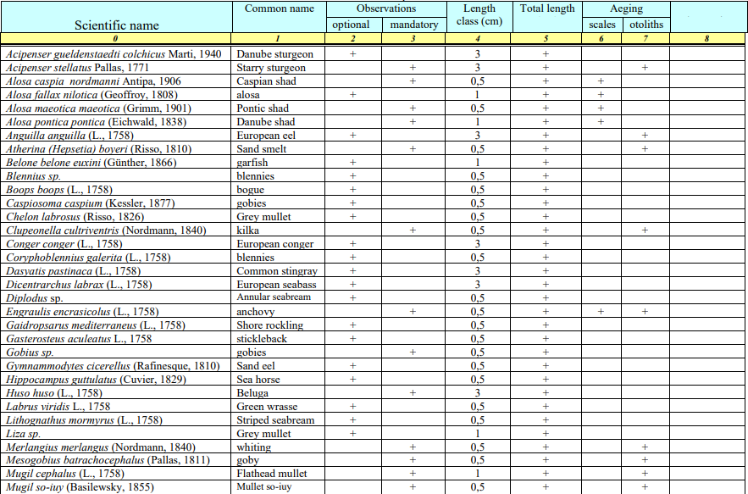
Important species fished in the Black Sea
with the indication of the samples that are collected

Slide 8
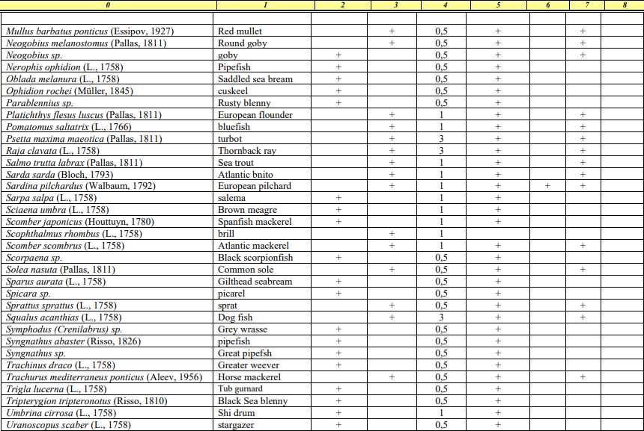
Important species fished in the Black Sea
with the indication of the samples that are collected

Slide 9
Statistical method
1. Swept areas method:
To determine the relative biomass of the reference species, the “swept area method” is applied. According to this method, trawl sweeps a well-defined path, the area of which is the length of the path times the width of the trawl, called the "swept area" or the "effective path swept", thus the swept area can be estimated from equation:
a = D * hr * X2,
D = V * t
V is the velocity of the trawl over the ground when trawling,
t is the time spent trawling,
hr is the length of the head-rope.
X2 is that fraction of the head-rope length, hr, which is equal to the width of the path swept by the trawl, the "wing spread", hr*X2,
D- distance covered.
2. Maximum sustainable yield:
Gulland’s formula for virgin stock is:
MSY = 0.5 * M * Bv; М – coefficient of natural mortality; Bv - biomass of virgin stock.
A generalized version of Gulland was proposed by Cadima (in Troadec, 1971) for exploited fish stocks for which only limited data are available for stock assessment:
MSY = 0.5 * Z * B, B - mean annual biomass; Z – total mortality.
Because Z = F + M and Y = F * B, Cadima suggested that in the absence of data for Z, the equation can be rewritten: MSY = 0.5 * (y + M * B)
y – total catch in one year, B - mean biomass in the same year.
3. Age and growth:
For the estimation of turbot growth rate, the von Bertalanffy growth function (1938) is used, (per Sparre, Venema, 1998
4. Natural mortality (M):
Pauly's empirical formula (1979, 1980) is applied

Slide 10
The design and implementation of statistical sampling schemes is placed under the responsibility of each country. In order to meet fisheries data requirements in existing EU / GFCM decisions, it may be necessary to improve, standardize and possibly modify current national data collection systems. A more efficient use of sampling resources may require the definition of best practices for sampling design and data analysis, with the aim to obtain accurate variable estimates with minimum bias and uncertainty levels.
It is fundamental that field collection, laboratory techniques and data processing be applied consistently and correctly. The integrity of the data should be also maintained and documented, from sample collection to entry in the data record. Countries are expected to keep, at the national level, standard data quality documentation as follows:
* A standard operating procedure which should include: - the quantitative goals of the monitoring programme; - the methodological details of all steps performed (e.g. fields and laboratory aspects); - details of the procedure related to the analysis and archiving of data. * A quality manual which should describe: - the quality assurance system in place; - the frequency at which different aspects of quality assurance should be reviewed; - the standards that should be met; - the actions needed if the standards are not met. Precision, accuracy, representativeness, completeness, and comparability are all components of the quality that should be taken into account.

Slide 11
THANK YOU
FOR THE ATTENTION!
Online Meeting, 16th of January 2025

